Slide 1
Step 1 : A - identify the data type for each attribute. B - Opened the file in python and We had imported two library pandas and matplot . C - Use the pandas data frame for easy access to the data. D - Calculated the mode and frequency for some attribute .

Slide 2
A
Record | Elapsed Time | Time in Community | Gender | Working | Age | Family
Nominal | Raito | Ordinal | Binary | Binary | Interval | Binary
Hobbies | Social Club | Political | Professional | Religious | Support Group
Binary | Binary | Binary | Binary | Binary | Binary

Slide 3
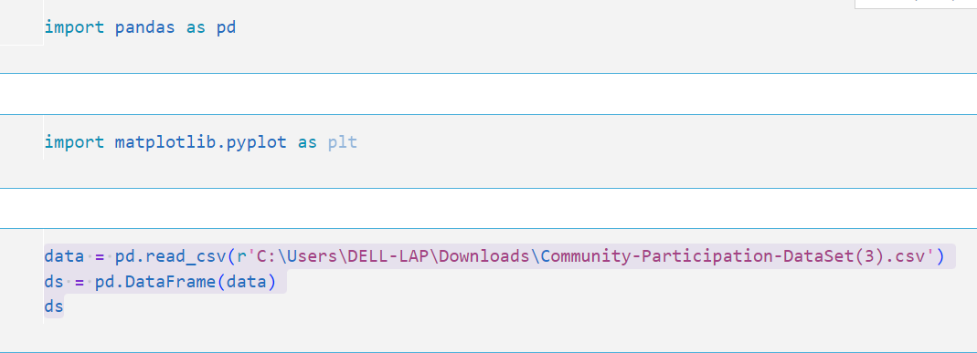
B and C

Slide 4
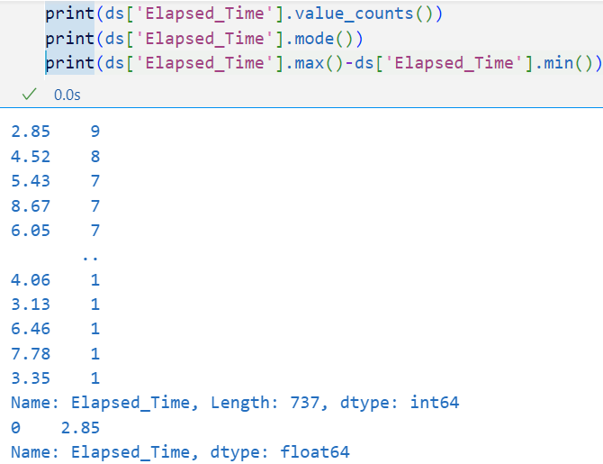
D

Slide 5
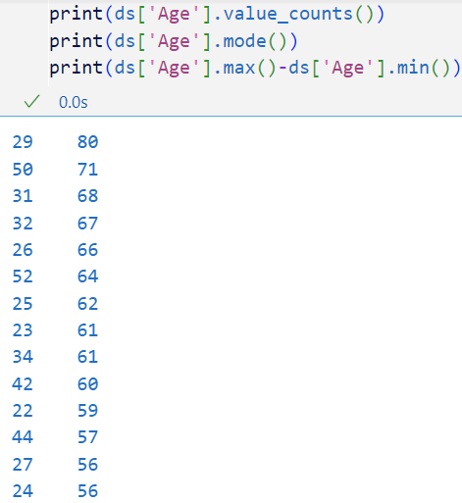
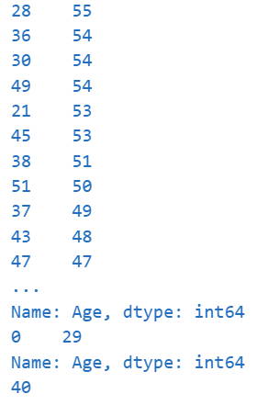
D

Slide 6
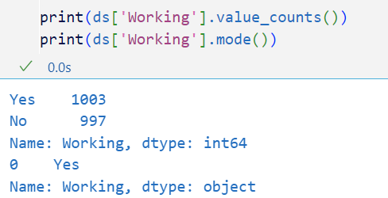
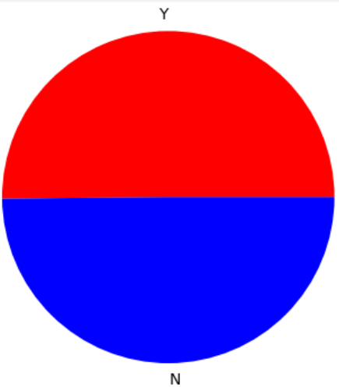
D

Slide 7
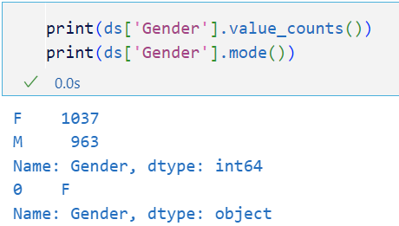
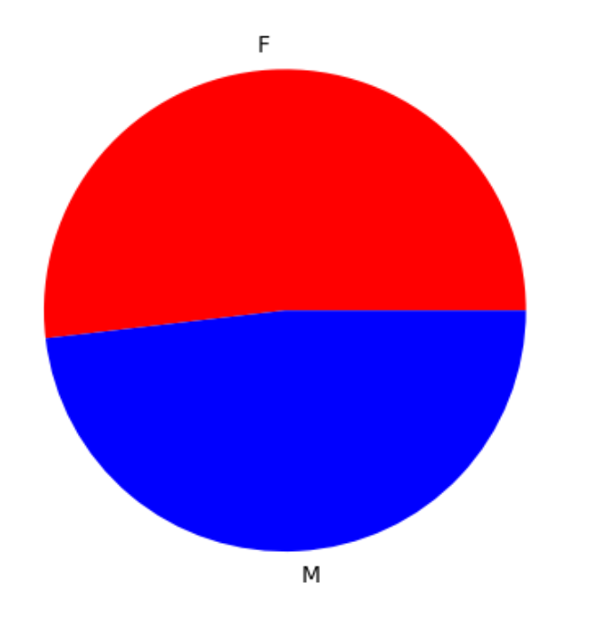
D

Slide 8
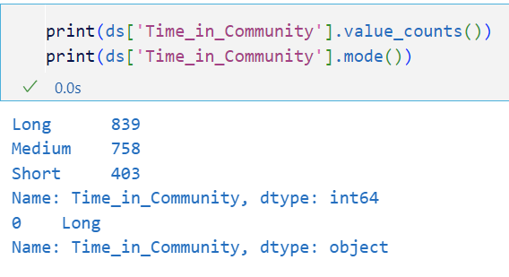
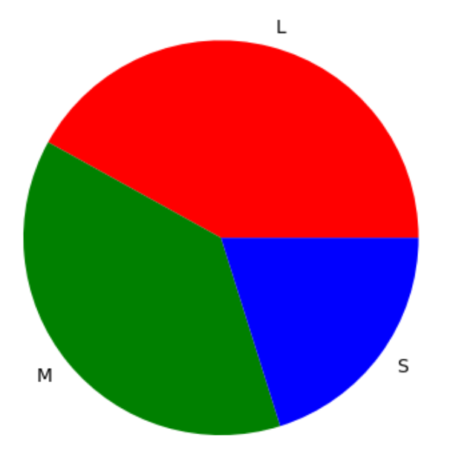
D

Slide 9
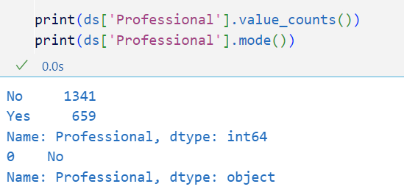
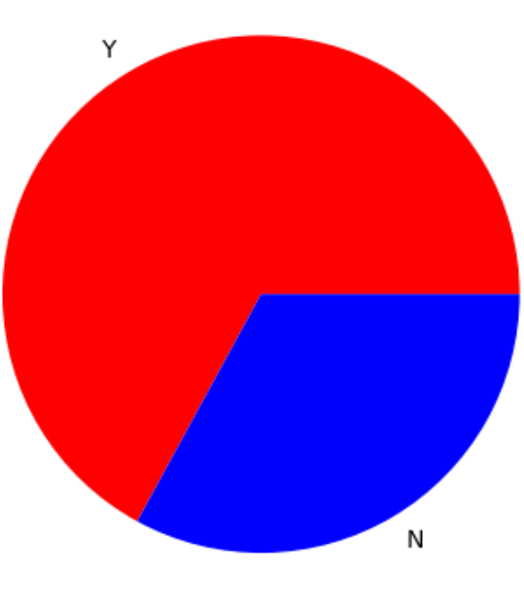
D

Slide 10
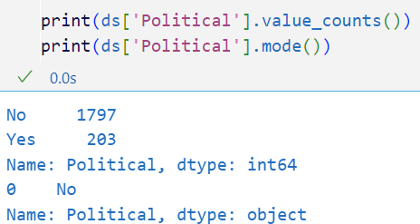
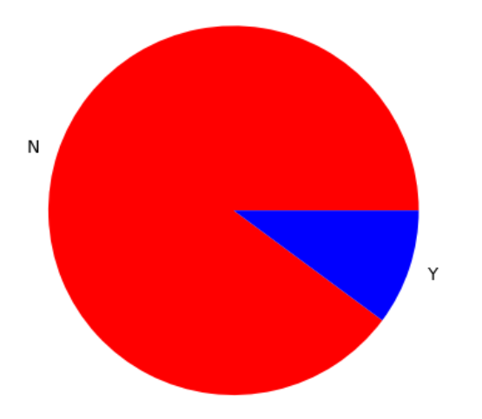
D

Slide 11
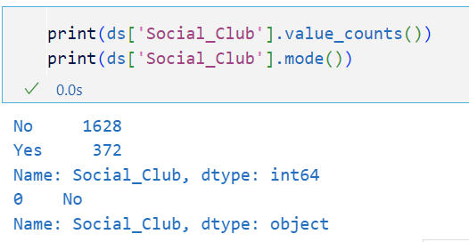
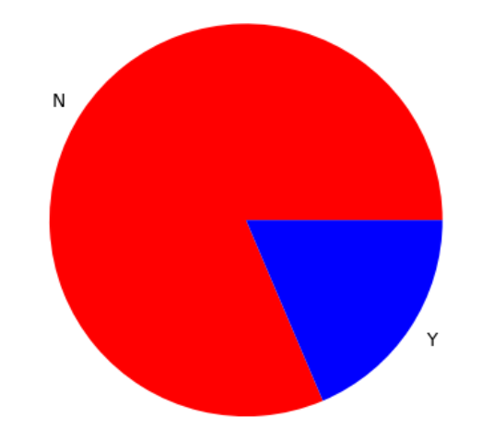
D

Slide 12
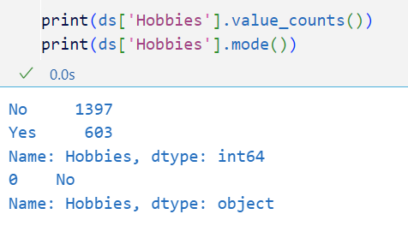
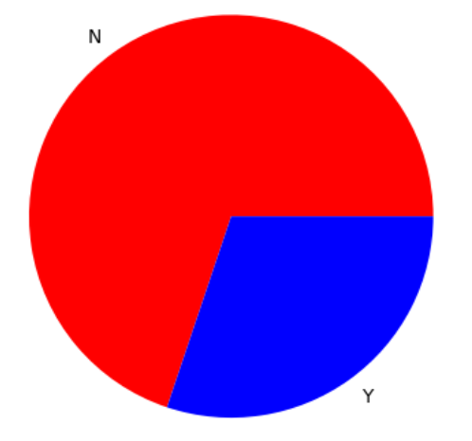
D

Slide 13
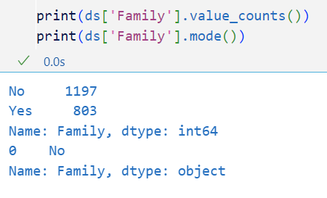
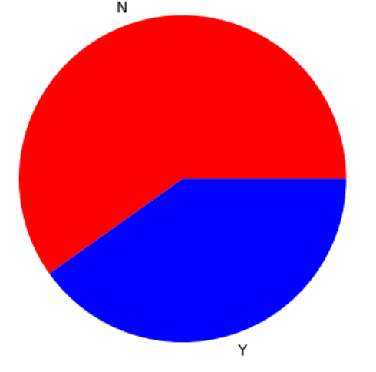
D

Slide 14
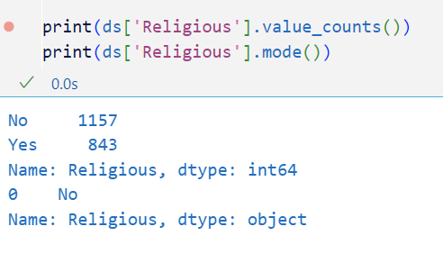
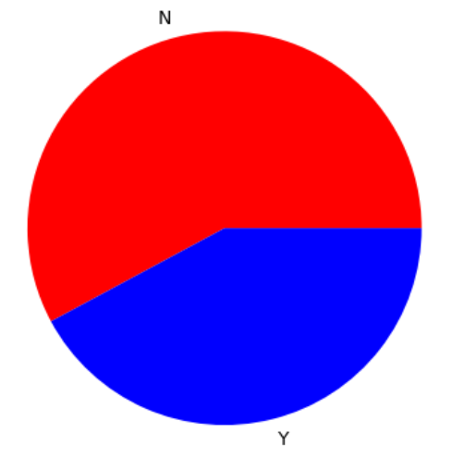
D

Slide 15
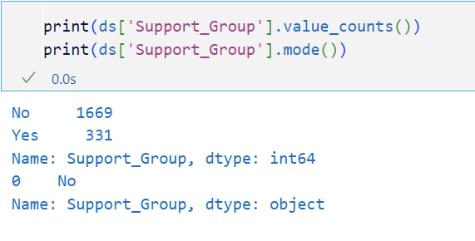
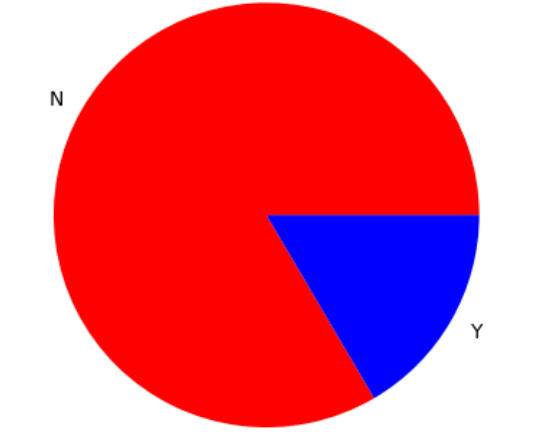
D

Slide 16
Step 2 : A - Calculated the mean for two numerical attribute . B - Calculated the median for two numerical attribute . C - Calculated the variance for two numerical attribute . D - C - Calculated the Standard Deviation for two numerical attribute .

Slide 17
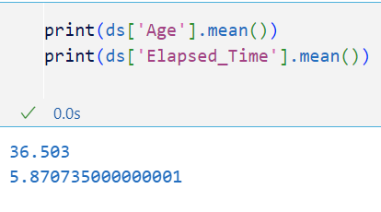
A

Slide 18
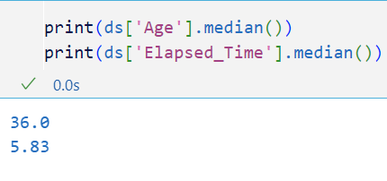
B

Slide 19
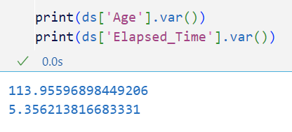
C

Slide 20
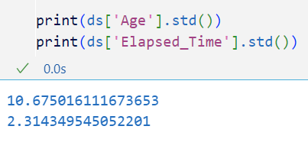
D

Slide 21
Step 3 : A - finding the five number summary . B - finding the outlier . C - Visualization for the outlier .

Slide 22
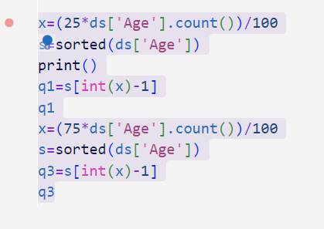
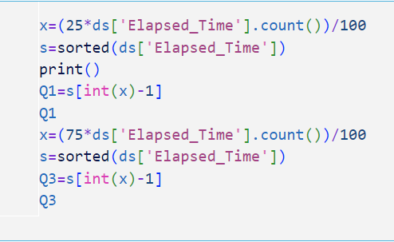
A

Slide 23
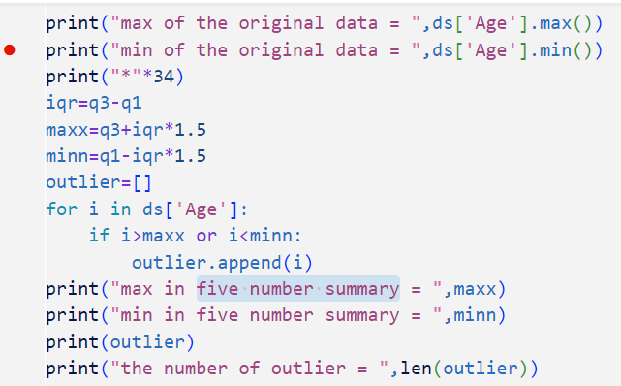
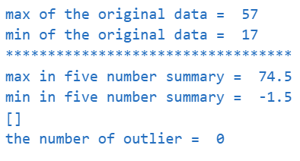
B

Slide 24
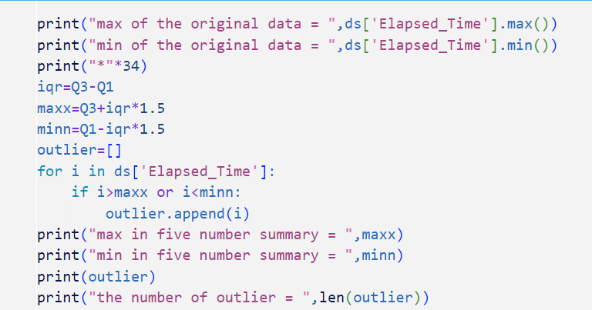
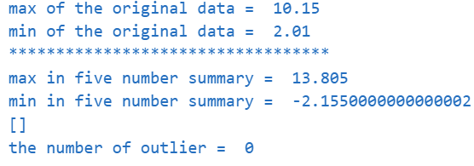
B

Slide 25
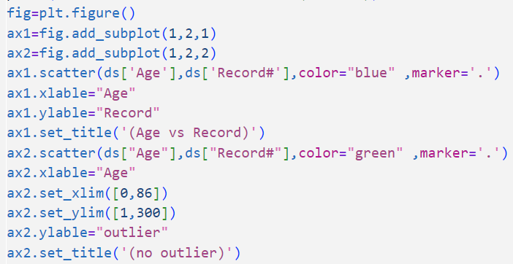
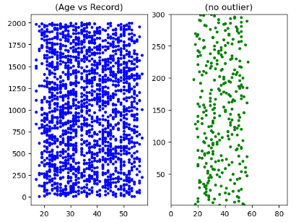
C

Slide 26
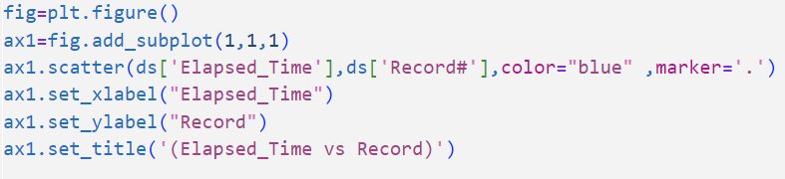
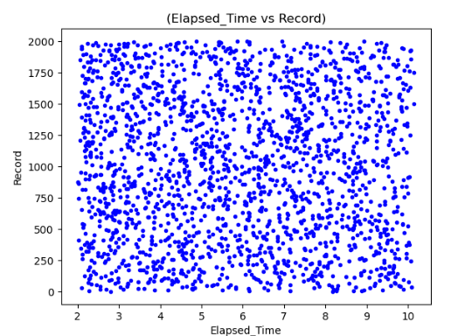
C

Slide 27
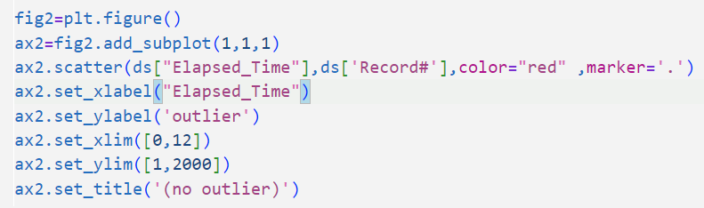
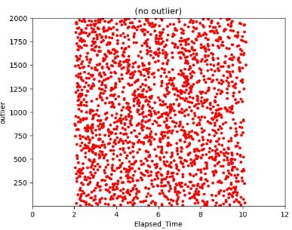
C

Slide 28
Step 4 : A - equi-width and equi-depth bining B - minmax and z-score normalization C - discretisation for the attribute (Age) D - convert the attribute (Gender) in to binary data type.

Slide 29
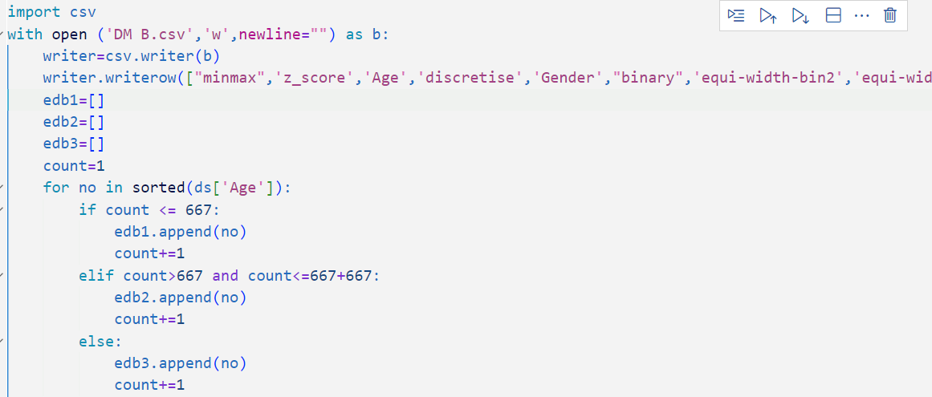
code

Slide 30
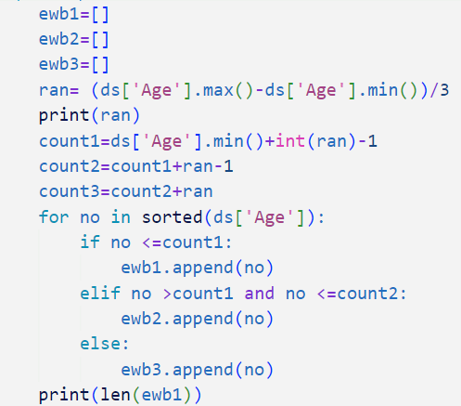
code

Slide 31
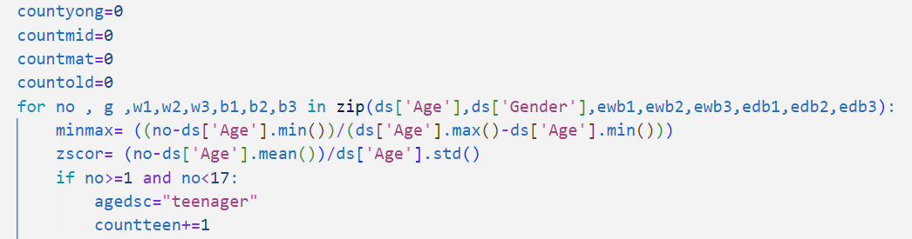
code

Slide 32
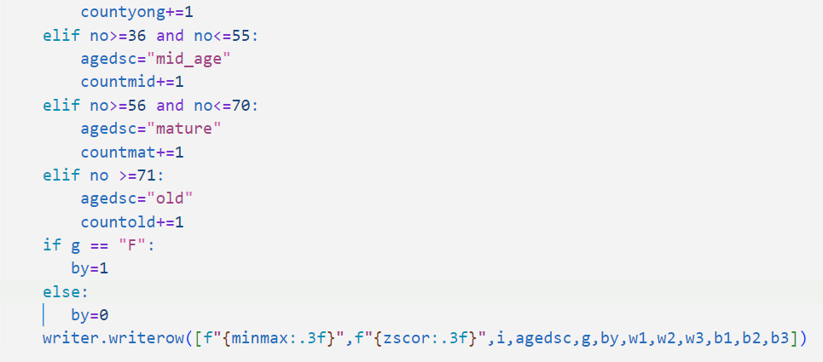
code

Slide 33
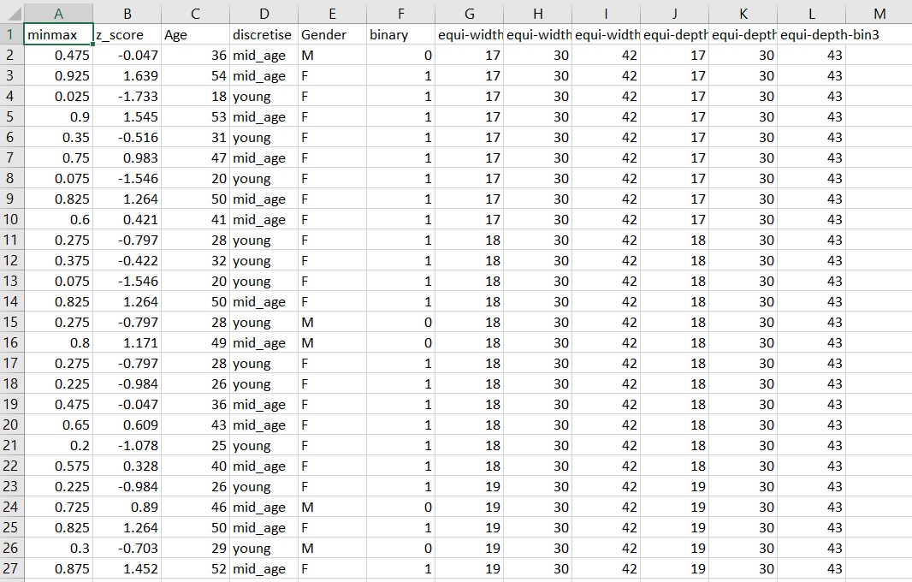
The result of the above code are in the Excel file (DM B)

Slide 34
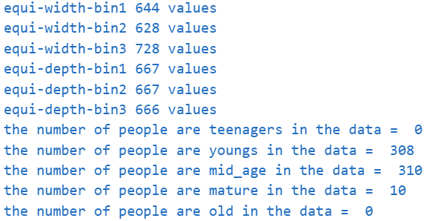
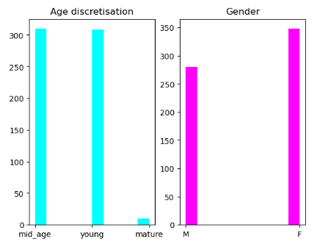
Some result and Visualization

Slide 35
Step 5: A - Finding the frequent item sets and extract association rules from it . B - Explanation of the code.

Slide 36
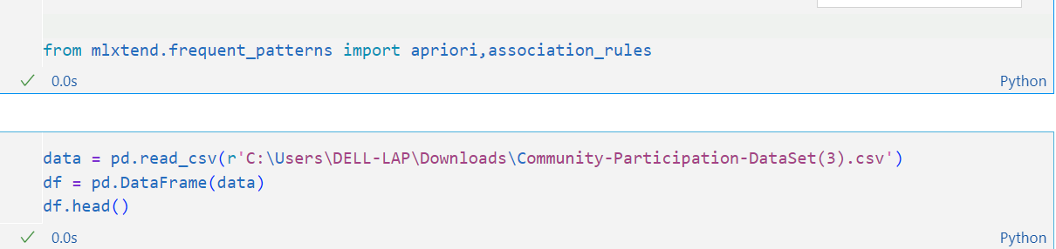
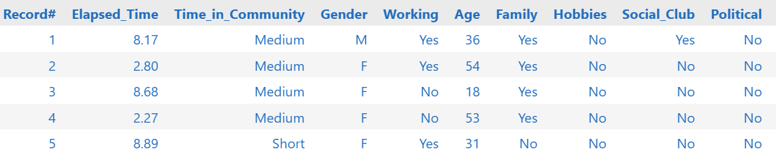
A

Slide 37
B
First we had imported the library (mlxtend)to use two methods
(apriori and association rules) and opened the file and converted it to a pandas data frame and printed the first five rows

Slide 38
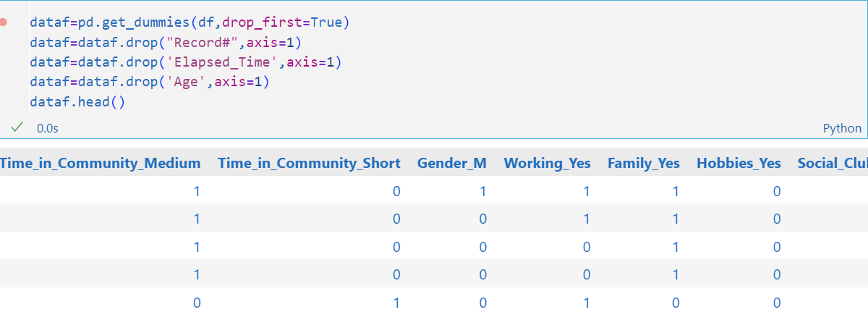
A

Slide 39
B
Converted the binary attribute from
(yes-no) to (1,0)
Then we dropped the attribute that can’t be binary
and printed the first five rows

Slide 40


A

Slide 41
B
Extracted the frequent item_sets
by using the (apriori)
method and put the
minimum support at 0.07
and printed the first ten rows

Slide 42


A

Slide 43
B
Extracted the association rules from the frequent item_sets by using (association_rules) method
and printed the first ten rows

Slide 44


A

Slide 45


B

